Slide 1
Friends of Reservoirs Sedimentation Briefing
Earl Conway
Conservation Director,
New Mexico BASS Nation
October 3, 2019
Sun Country Outdoors
Notes:
https://woolpert.com/wp-content/uploads/2019/08/National-Res-Sed-White-Paper-2019-06-21.pdf
New Mexico Bass Nation Conservation: Provide conservation leadership by developing and supporting actions to protect, improve and sustain quality aquatic resources and user access.
Earl Conway, (505) 610-5156, way2busy2fish@aol.com

Slide 2
Here we are!
“Whereas the twentieth century focused on the construction of new dams, the twenty-first century will necessarily focus on combating sedimentation to extend the life of existing infrastructure. This task will be greatly facilitated if we start today”
( Morris & Fan, 1998)

Slide 3
https://woolpert.com/wp-content/uploads/2019/08/National-Res-Sed-White-Paper-2019-06-21.pdf
Notes:
https://woolpert.com/wp-content/uploads/2019/08/National-Res-Sed-White-Paper-2019-06-21.pdf
https://acwi.gov/sos/nrsst/

Slide 4
Collaborative Effort

Slide 5
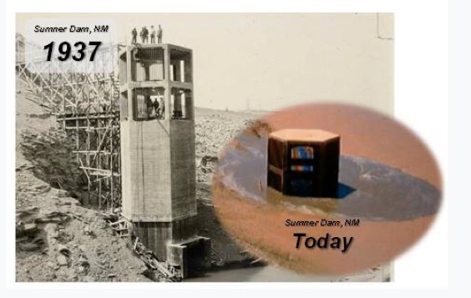
Too Late for Some NM Reservoirs?
Notes:
https://www.usbr.gov/research/docs/ks/ks-2016-02.pdf

Slide 6
Whitepaper Goal
“long-term sediment management strategies to preserve the benefits of the nation’s reservoirs for our own children and future generations”
Notes:
With the possible acceleration of sedimentation under new climate change scenarios, the issue could reach the attention of an unsettled younger generation sooner than expected.

Slide 7
Impacts of Sedimentation
Environmental impacts (fish and birds hit hardest)
Reduction in storage volume
Reduction of reliable water supply
Burial of dam outlets and water intakes
Reduced power production (turbine erosion and blockage)
Burial of boat ramps and marinas
Impaired navigation (rescue costs)
Increase in evaporation (Surface area : Volume ratio)
Reduction of useable surface area for recreation
Increase in upstream flood levels
Loss of flood control capabilities
Long term costs of Dam maintenance or removal
Notes:
One of the most obvious impacts from reservoir sedimentation is the loss of water-storage capacity, which will eventually lead to the reduced reliability of water and power supply. Reduced reliability will have the largest impact in regions exposed to multiple-year droughts, which may be exacerbated by the effects of climate change. Other impacts often occur long before the reservoir completely fills with sediment: ●Burial of dam outlet sandwater intakes ●Reduced water depths, interfering with or preventing operation of boat marinas, and burial of boat ramps, as well as changes in aquatic habitat that may impact species use and survival. ●Reduction in surface area for recreation. ●Increased dam safety risks from sediment loads against the dam, abrasion of outlets and spillways, and loss of functioning outlets. ●Aggradation of upstream channels, which can lead to reduced conveyance capacity, increased flooding, and increased ground water table elevations (which can cause waterlogging and soil salinization). Trapping sediment behind dams, meanwhile, also impacts the downstream channel areas: ●Degradation of the downstream channel bed and stream-bank erosion .●Alteration of downstream channel and riparian habitat.

Slide 8
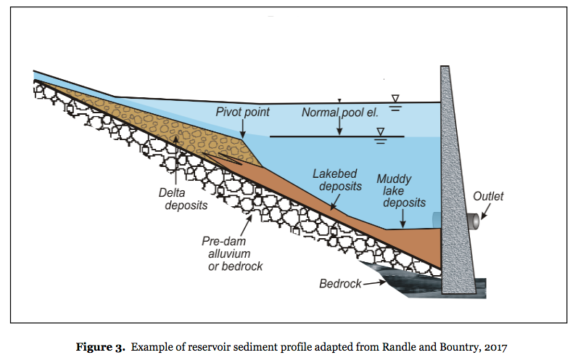
Typical Sedimentation Profile
Dams: Manmade aggregate sorting and storage structure

Slide 9
Main Take Aways
The sustainable management of reservoir sedimentation may seem expensive, but the sediment management costs need to be compared with the costs of eventually losing the reservoir benefits and the costs of its removal.
management plans should include either the implementation of sustainable sediment-management practices or the eventual retirement and replacement of the reservoir
Plans to periodically monitor reservoir sedimentation need to be formulated and implemented at each reservoir to document the remaining storage capacity and estimate when important dam and reservoir facilities (operations) will be impacted
Notes:
Whereas the twentieth century focused on the construction of new dams, the twenty-first century will necessarily focus on combating sedimentation to extend the life of existing infrastructure. This task will be greatly facilitated if we start today” (
Morris & Fan, 1998)

Slide 10
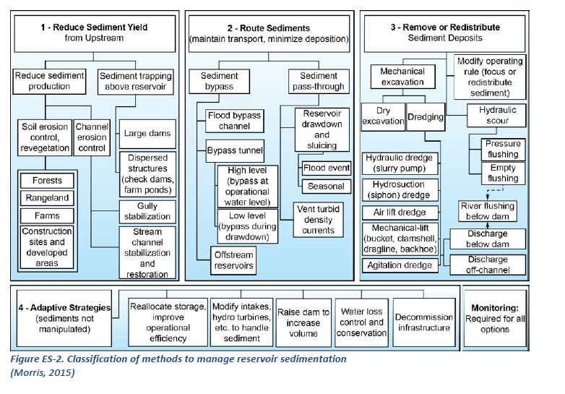
Management Strategies

Slide 11
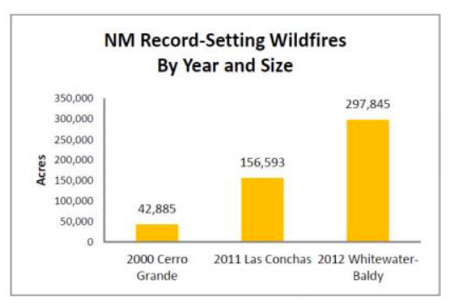
Times are Changing
Trends are there even if the science isn’t
More severe droughts – Bigger wildfires
Stronger storms – massive floods/erosion
Notes:
Greater variability in hydrologic events, with more frequent floods and droughts,will reduce the reliability of a reservoir water supply. Reservoir water levels reduce during droughts and refill during floods. However, the rates of sediment entering a reservoir increase significantly during floods. With lower initial reservoir levels, sediments can be carried farther into the reservoir, closer to outlet works. We intuitively expect droughts to deliver lower-than-average sediment loads to reservoirs, but recent research has shown that this is not true. In Texas, researchers found that drought increased upland sediment yield dramatically. The reduction of vegetative cover during the drought left the rangeland so vulnerable to erosion that this factor outweighed the reduction in rainfall frequency, intensity and erosivity. The net effect was a 70-fold increase in the sediment yield,compared to relatively drought-free conditions that prevailed after 1970 (Dunbar, et al, 2010).

Slide 12
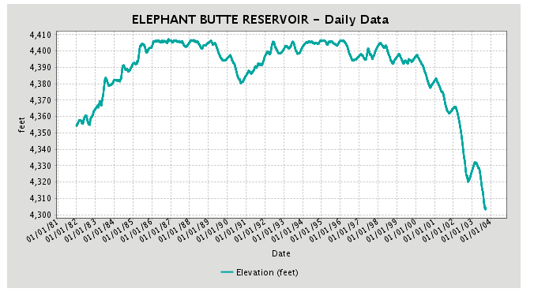
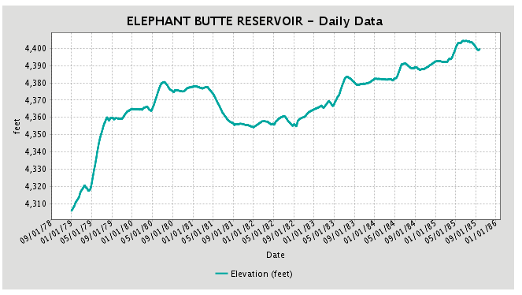
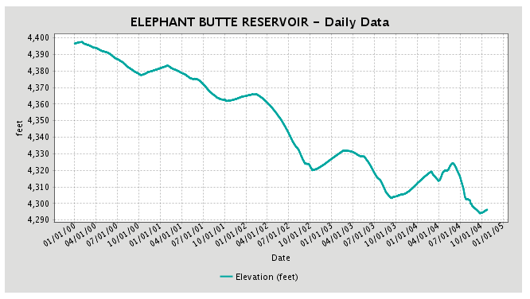
We are in an era of down-cutting but it could get a lot worse
Deposition south of narrows after 2002
North filled with sediments first
Conveyance Channels dredged
The droughts can be much worse!
Notes:
See “What Made Elephant Butte so Good?” Earl Conway 2013
Elephant Butte Reservoir was listed as one of the Top Ten bass lakes in the nation in 1994 by B.A.S.S.
The first area to rapidly fill with sediments was the northern five mile reach when the levees were breached in 1994.
After 2002, the sediment delta began forming at the south end of “The Narrows” about river mile 38. Since then it has expanded to most of the reservoir north of Kettle Top Mesa.

Slide 13
Stop the Bleeding - Erosion
Erosion management is perhaps the most widely recommended but most poorly implemented sediment management technique because land users may not see any direct benefits from controlling sediment yield. (Grummer, J. )
Must be a coordinated effort by private Land owners, BOR, BIA, BLM, Tribes/Pueblos, DOT, USFWS, Non-profits, etc….
Notes:
Notes: (a) Measured Load expressed as % fines. (b) From the 2004-2006 Integrated CWA 303(d)/305(b) list (NMED/SWQB 2004a). This list of probable sources is based on staff observation and known land use activities in the watershed. These sources are not confirmed or quantified at this time. Watershed Restoration Action Strategy (WRAS)
The Rio Puerco (fig. 2) carries exceptionally high sediment loads, and is the major source of suspended sediment entering the Rio Grande; on average, the Rio Puerco delivers 78% of the total suspended sediment load of the Rio Grande although it drains only 26% of the Rio Grande Basin and provides only 4% of the runoff. https://geochange.er.usgs.gov/sw/impacts/geology/puerco1/

Slide 14
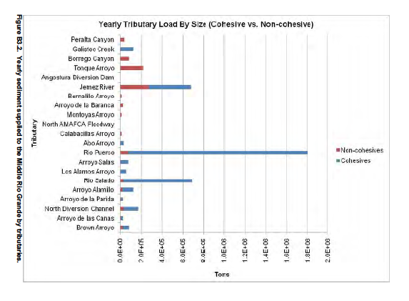
The Elephant Butte Story
25% of the original capacity is gone!

Slide 15
The Butte would be better if:
Reservoir storage doesn’t fall below 60,000 acre-feet
The reservoir didn’t drop more than 6 inches a day during the spring
Sediments are no longer filling and killing the reservoir
Terrestrial vegetation is propagated instead of removed
Existing sediments are removed to create and restore habitat
There is a prevention and contingency plan for invasive species
Recreation was acknowledged by Reclamation as a project objective
Upriver ponds are accessible and usable for recreation & rearing fish
Notes:
50,000 acre=feet is about equivalent to 4280 feet elevation based on recent data tables. Elephant Butte was at it’s lowest on 25-Sep-2018; 4285.66ft and 58240af

Slide 16
Effects of rapid water fluctuations
Increased fish disease and mortality
Loss of entire age classes
Kills aquatic vegetation
Disconnects shoreline habitat from water
Interrupts natural vegetation propagation
Increases erosion and sedimentation
Increases turbidity during draw downs
Disrupts benthic process
Reduces spawning success
Increases boating hazards
Increases cost of marina and park operations
Notes:
Several sources are available but some of the most interesting material is from Europe where they have reservoirs that are over 1000 years old. See other notes.

Slide 17
Priority 2. Stop/reverse Sedimentation (or there won’t be a reservoir in 100 years)
2a. Prepare a 100-year draft sediment management plan for Elephant Butte Reservoir as part of 2020 budget submittal that encompasses the Rio Puerco and Rio Salado watersheds (Congress and Reclamation)
2b. Intensify erosion control measures in the Rio Puerco and Rio Salado watersheds. Progress has been good by BLM but much more needs to be done to create an entrenchment channel. (Reclamation, BLM, BIA, USDA/NRCS, State Conservation Districts)
2c. Remove at least 6000 acre-feet of sediment from the Elephant Butte full pool annually in a sedimentation pilot project (Reclamation)
2d. Build check dams in arroyos on the west side of the reservoir to protect roads and reduce sedimentation in park areas (BLM)
2e. Build check dams or bypass channels to protect the Caballo dam operations (Reclamation, BLM)
2f. Expedite restoration of native grasslands on adjacent BLM lands (BLM)
2g. Encourage using native vegetation to stabilize existing sediment and prevent further arroyo and bank erosion within the full pool (Reclamation)
2h. Incentive private ranchers and farmers to control erosion by reducing or eliminating matching requirements for erosion control projects (USDA)
2i. Establish water quality standards (turbidity) for in-flow and upper reservoir storage conditions (Reclamation and State)

Slide 18
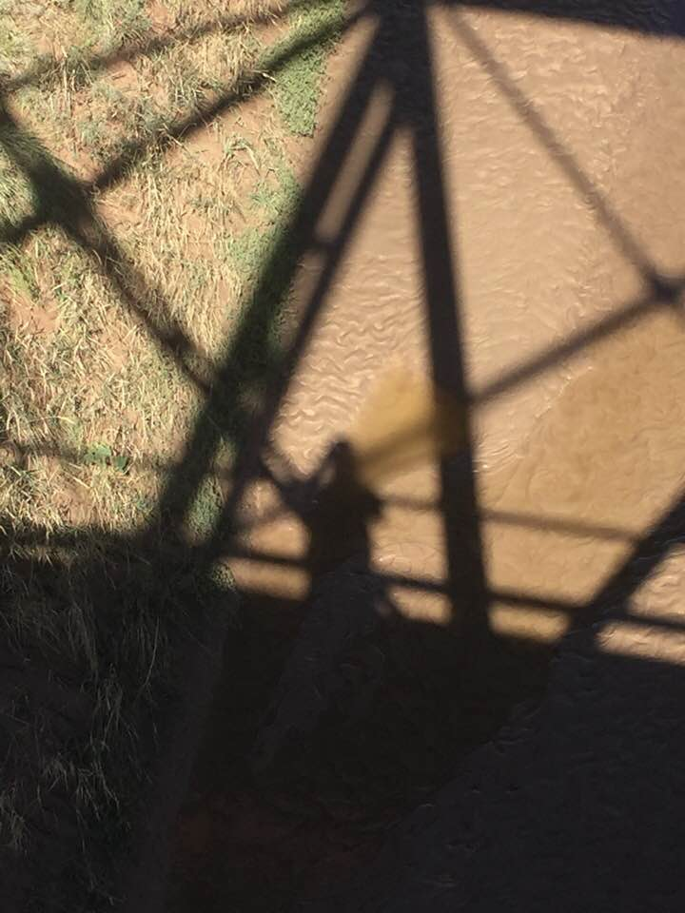
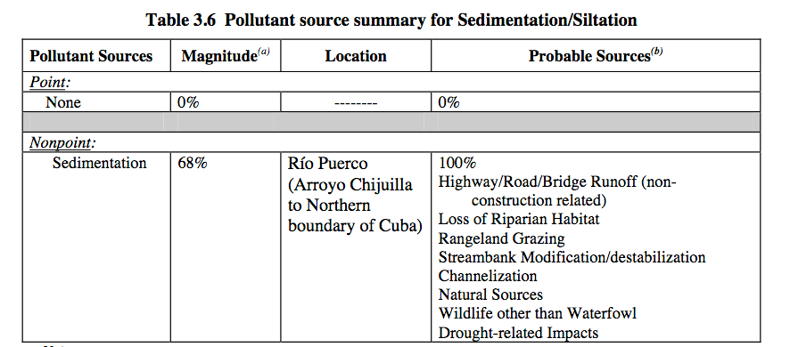
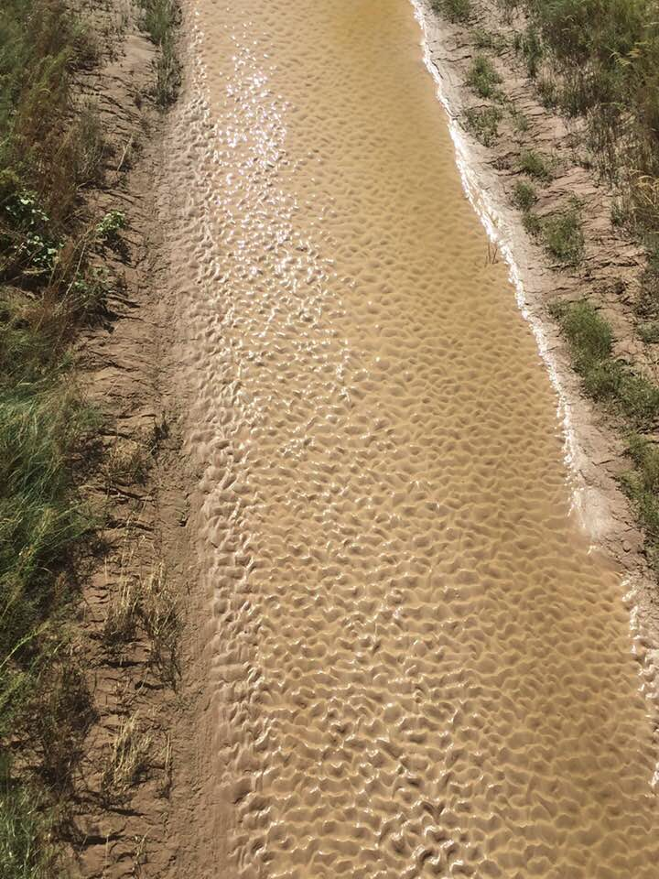
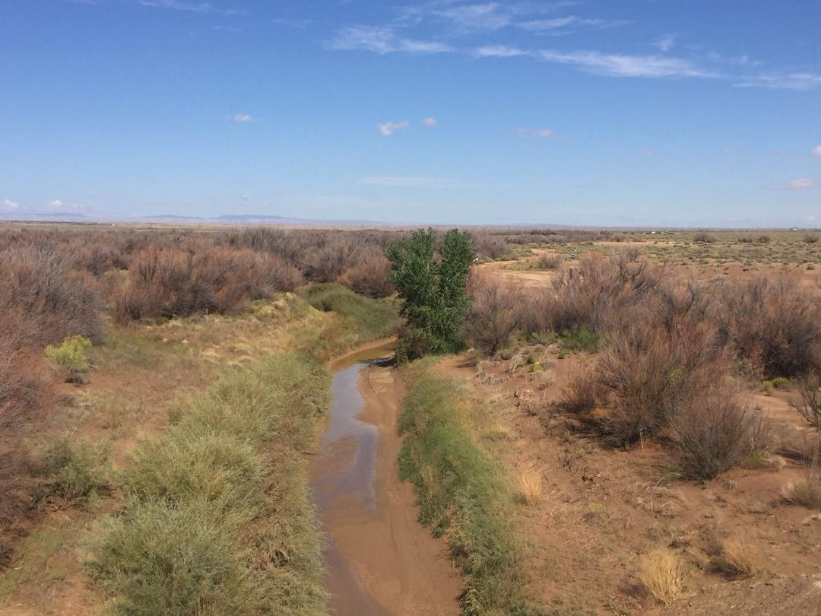
Rio Puerco Mud
Over half of the load can be silt

Slide 19
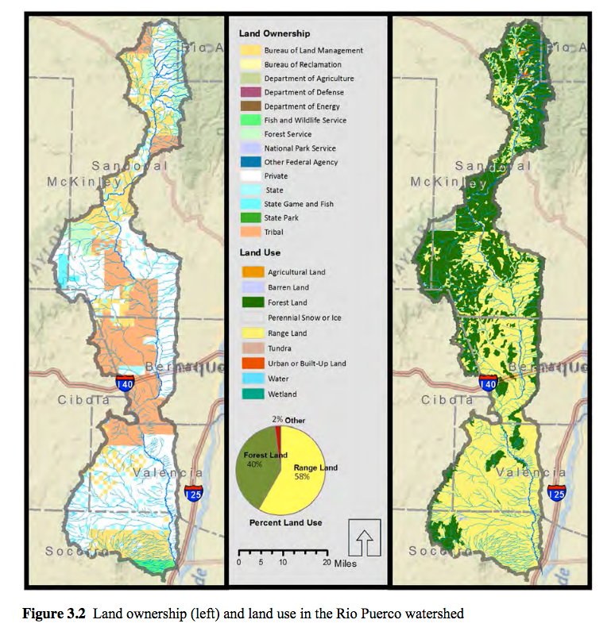
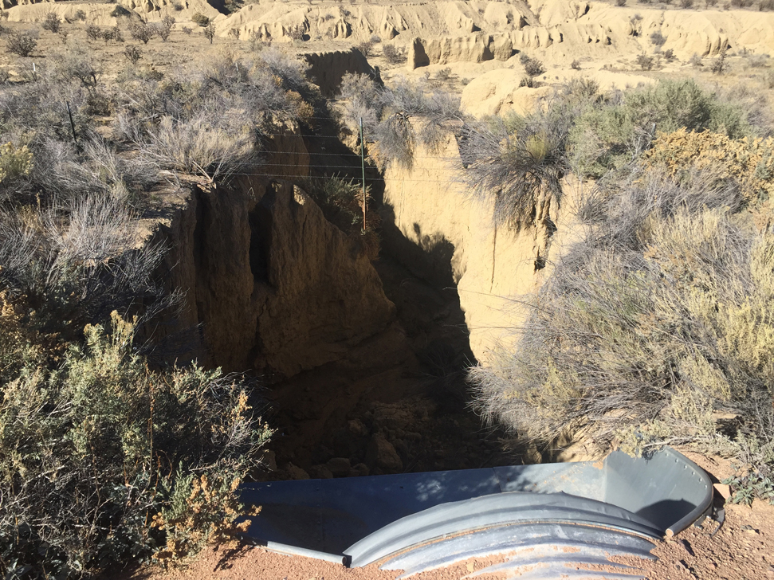
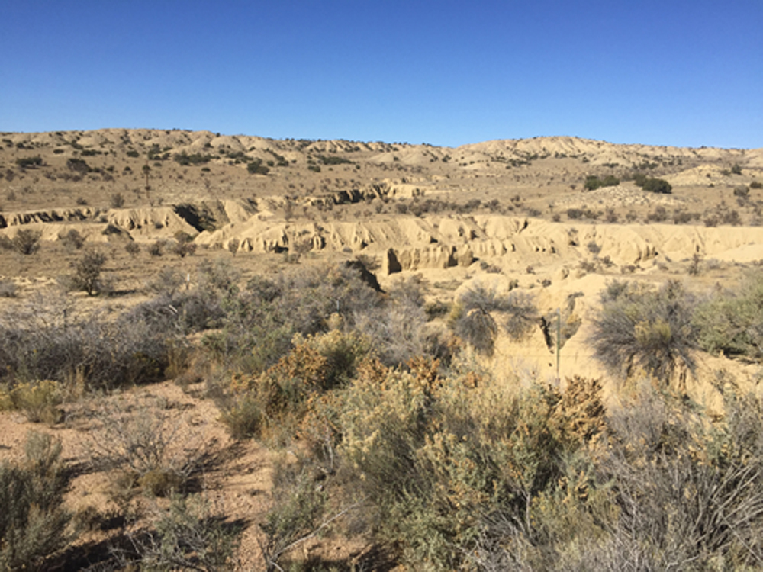
Rio Puerco Watershed Protection
Challenges:
Huge landscape – huge job
Unjustifiable cost/benefit ratio for managers/owners (no big picture)
Multiple owners
Environmental hurdles
Notes:
In 1926, saltcedar was introduced to the Rio Puerco watershed to limit erosion and prevent the infilling of Elephant Butte Reservoir. In September 2003, herbicide spraying along a 12 km section of the Rio Puerco killed all woody vegetation. A major flood 3 years later caused extensive erosion and channel widening along the devegetated reach; the eroded material was deposited downstream where living vegetation prevented erosion. Because the vegetation was the only factor that varied along the middle reach of the river, the 2006 Rio Puerco flood makes an excellent natural experiment for testing coupled hydraulic-morphodynamic flood models.

Slide 20
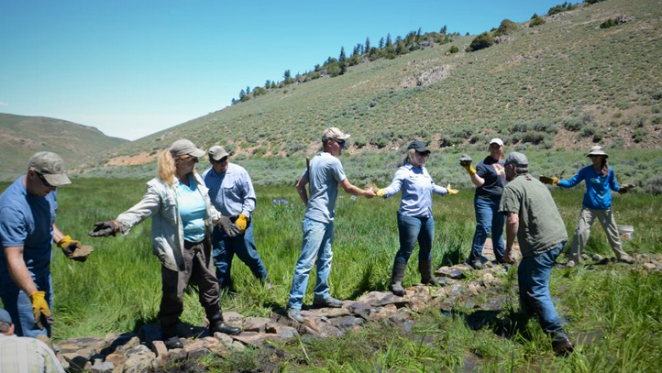
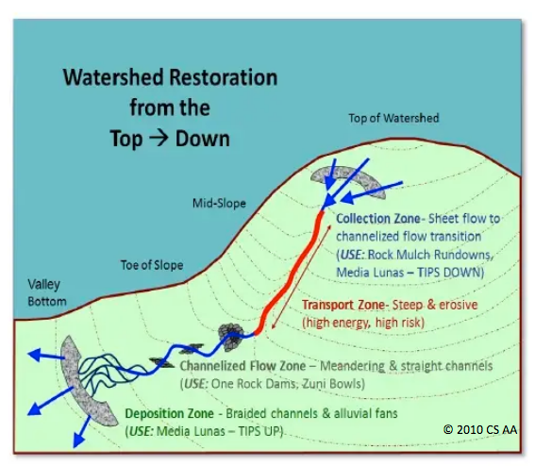
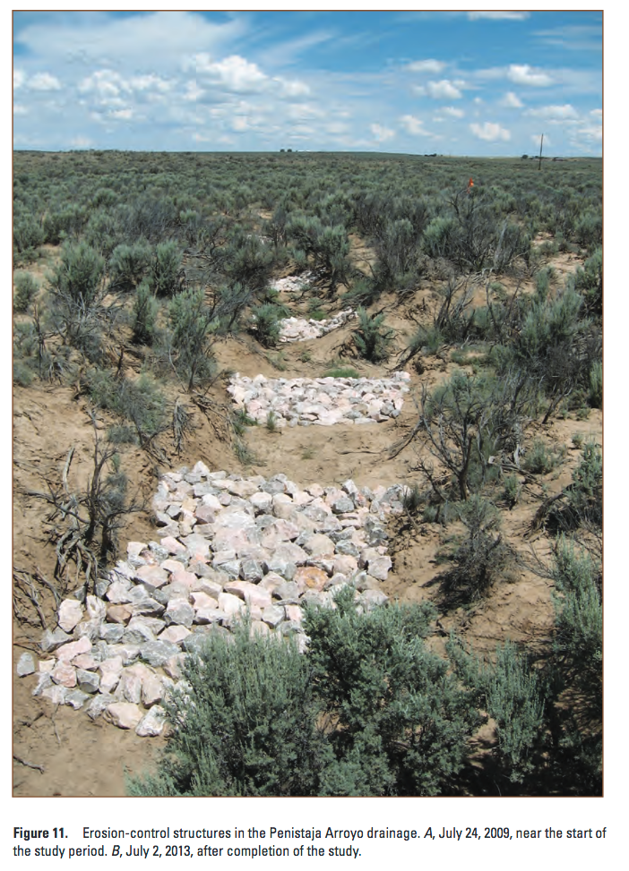
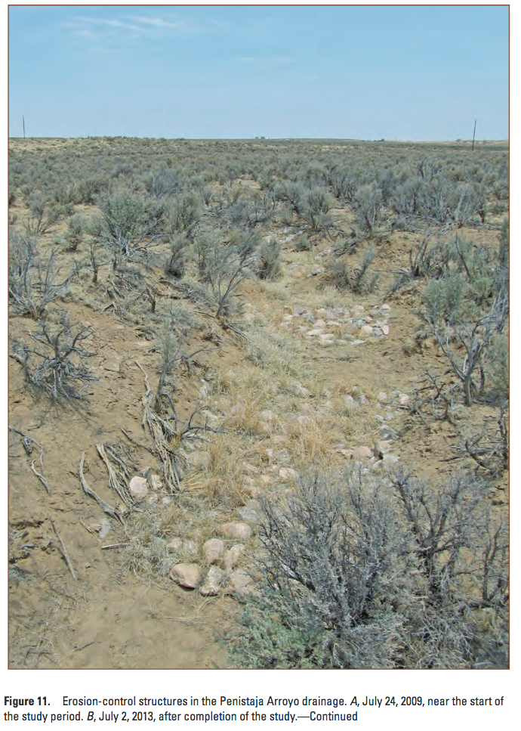
One-Rock dams and Other solutions
Notes:
Attacking the erosion and sediment at the source may be the only affordable and viable option in the future. The effort will include a new and even more diverse community of conservationists with common goals but possibly different agendas and ideals.
http://riopuerco.org/Projects/Watershed_Initiative/
http://www.azwpf.gov/Grant_Project_Reports/documents/FinalReport09-163WPF.pdf

Slide 21
Conclusion
Spread the word about the whitepaper
Demand plans for reservoirs in your area
Think watersheds, not just reservoirs
Embrace and encourage watershed efforts
Sage Grouse Initiatives
Wildlife Corridors
Other ESA interests
Know your reservoir’s sediment survey (s)

